Slide 1


HANDCRAFT MEDIA
Guided by Submitted by
Dr Madhu bhan Swapnil sahu
Assistant Professor 1MS21MC057

Slide 2
1. Introduction
Amplifying Artistic Talents: Handcraft Media Application is dedicated to celebrating the unique talents of artisans. By providing a dedicated space for showcasing their creations, artisans can gain exposure to a wider audience, allowing their work to be appreciated and valued.
Seamless Integration with Social Media: Our application leverages the power of social media by allowing artisans to connect their registered accounts. This integration enables them to effortlessly market their products and engage with customers, creating meaningful relationships and fostering a loyal customer base.
Streamlined Buying and Selling Experience: We understand the importance of a smooth and convenient buying and selling process. Our application offers intuitive features that make it easy for artisans to list their products, manage inventory, and process transactions. Customers can explore a wide range of unique handmade goods, effortlessly purchase their desired items.
Community Building and Collaboration: Handcraft Media Application thrives on the strength of its community. Artisans and creators can connect, share ideas, and collaborate on projects. This collaborative environment encourages the exchange of knowledge, inspiration, and support among fellow artisans, fostering personal and professional growth.
Empowering Side Businesses: The Handcraft Media Application recognizes the potential for individuals to turn their passion for crafting into a viable side business. Whether it's generating extra income or exploring entrepreneurial aspirations, our platform provides a supportive ecosystem for anyone looking to start their own venture.

Slide 3
1.2 Problem Statement:
Problem: The handcraft industry is facing challenges in reaching its target audience and competing in the market due to limited online presence and lack of a centralized platform for showcasing and selling handcrafted products.
Purpose: To create a platform that provides a centralized marketplace for handcraft makers to showcase and sell their products, while also addressing the needs of the customers who are looking for unique and high-quality handcrafted items.

Slide 4
3. Literature Survey
HANDLOOM AND HANDICRAFT SECTOR IN INDIA: A REVIEW OF LITERATURE ON ITS DEMAND IN THE MARKET AND AVAILABILITY OF ORIGINAL PRODUCT
The reviewed paper titled "Handloom and Handicraft Sector in India: A Review of Literature on its Demand in the Market and Availability of Original Product" by Ms. Akshita Agrawal and Prof. (Dr.) Bhawana Chanana focuses on the revival and availability of traditional textiles, handloom, and handicrafts in the Indian market. The paper highlights the decline of handlooms and handicrafts in India due to the emergence of low-cost synthetic or machine-made materials, which have overshadowed the traditional crafts and lack of online platform which can boost the sale.
DIGITAL TECHNOLOGIES AS TOOL FOR INCREASING THE COMPETITIVENESS OF THE HANDICRAFT INDUSTRY Jovanka Damoska Sekuloska, PhD1 Aleksandar Erceg, PhD2
The Author suggest that the use of digital technologies and online platforms provides export opportunities and facilitates interactions between producers and consumers. The author argues that today's competitiveness in the handicraft market is not solely based on price and quality, but also on engaging customers through content creation and personalized services. Digital technologies are seen to reemerge and achieve new market growth for handicrafts, redefining the value of craftsmanship and expanding market boundaries.

Slide 5
3. Literature Survey
The social media marketing strategies and its implementation in promoting handicrafts products: a study with special reference to Eastern India
The conclusion suggests that informative posts about handicraft products on social media attract consumers' attention by providing new information. Studies indicate that once a brand or product becomes well-known, people may lose interest. However, when informative posts incorporate entertaining elements, they become highly effective in attracting views and engaging users.
MARKETING CHALLENGES OF HANDICRAFT RETAILERS IN CHANGING ENVIRONMENT
In conclusion, encouraging youth to engage in handicraft retailing can be beneficial. The government plays a crucial role by disseminating information about schemes, financing options, marketing assistance, and offering training opportunities. These measures aim to help young entrepreneurs compete with cheaper substitutes, particularly from China. By supporting and empowering the youth in the handicraft industry, governments can contribute to the preservation of traditional crafts and promote economic growth in this sector.

Slide 6
4. Methodology
4. Methodology
Following the research phase, we proceed with the design and planning stage. This involves creating a user-centric design that focuses on providing a visually appealing and intuitive interface for both artists and buyers. Wireframes and prototypes are developed to outline the application's structure and functionality, ensuring a seamless user experience.
Once the design is finalized, we move on to the development phase. We build the application, leveraging robust programming languages, frameworks, and tools. The development process incorporates agile methodologies, allowing for iterative development and continuous improvement.
Finally, we document the entire methodology and project details, including design decisions, technical specifications, and implementation guidelines. This documentation serves as a valuable resource for future maintenance, updates, and scalability of the handcraft-media e-commerce application.
By adhering to this methodology, we aim to deliver a high-quality, user-friendly, and secure handcraft-media application that meets the needs of artists and buyers, fosters community engagement, and promotes the growth of the handcrafted media industry.

Slide 7
5. Implementation
Set up the development environment: Prepare the necessary software and tools required for building the application. This includes setting up a version control system, selecting a programming language and framework, and configuring development environments.
Create the application infrastructure: Establish the foundations of the application by setting up servers, databases, and other infrastructure components. Consider scalability and performance requirements to ensure the application can handle increasing user demands.
Develop the backend: Implement the server-side logic and functionality of the application. This involves designing and developing APIs, handling data storage and retrieval, implementing user authentication and authorization, and integrating with external services if needed.
Build the frontend: Develop the user interface components of the application using web technologies such as HTML, CSS, and JavaScript. Implement the wireframes and prototypes created during the design phase, ensuring a visually appealing and intuitive user experience.
Implement core features: Focus on implementing the essential features of the handcraft-media application. This may include functionalities such as artist profile creation, artwork listing, search and filtering options, shopping cart management, payment integration, and order tracking.
Enable social interactions: Implement features that promote community engagement among artists and buyers. This can include features like comments and reviews, messaging and chat functionality, social sharing options, and user-generated content capabilities.

Slide 8
6. Results and Discussion
A handcrafted e-commerce business application project is a software application developed to support and manage the sales of handcrafted products through an online platform. The results of such a project would depend on various factors such as the functionality, user-friendliness, and marketing efforts.
In terms of results, a successful handcrafted e-commerce business application project can lead to increased sales, improved customer experience, and enhanced brand recognition. A well-designed and user-friendly application
can help simplify the purchasing process and improve customer satisfaction.
In terms of discussion, some key aspects to consider for the success of a handcrafted e-commerce business application project include:
Functionality: Ensuring that the application has the necessary features and functions to support the sales of handcrafted products, such as product catalog, shopping cart, and payment gateway integration.
User-friendliness: Developing an application that is easy to navigate and use can help improve the overall customer experience and encourage repeat purchases.

Slide 9
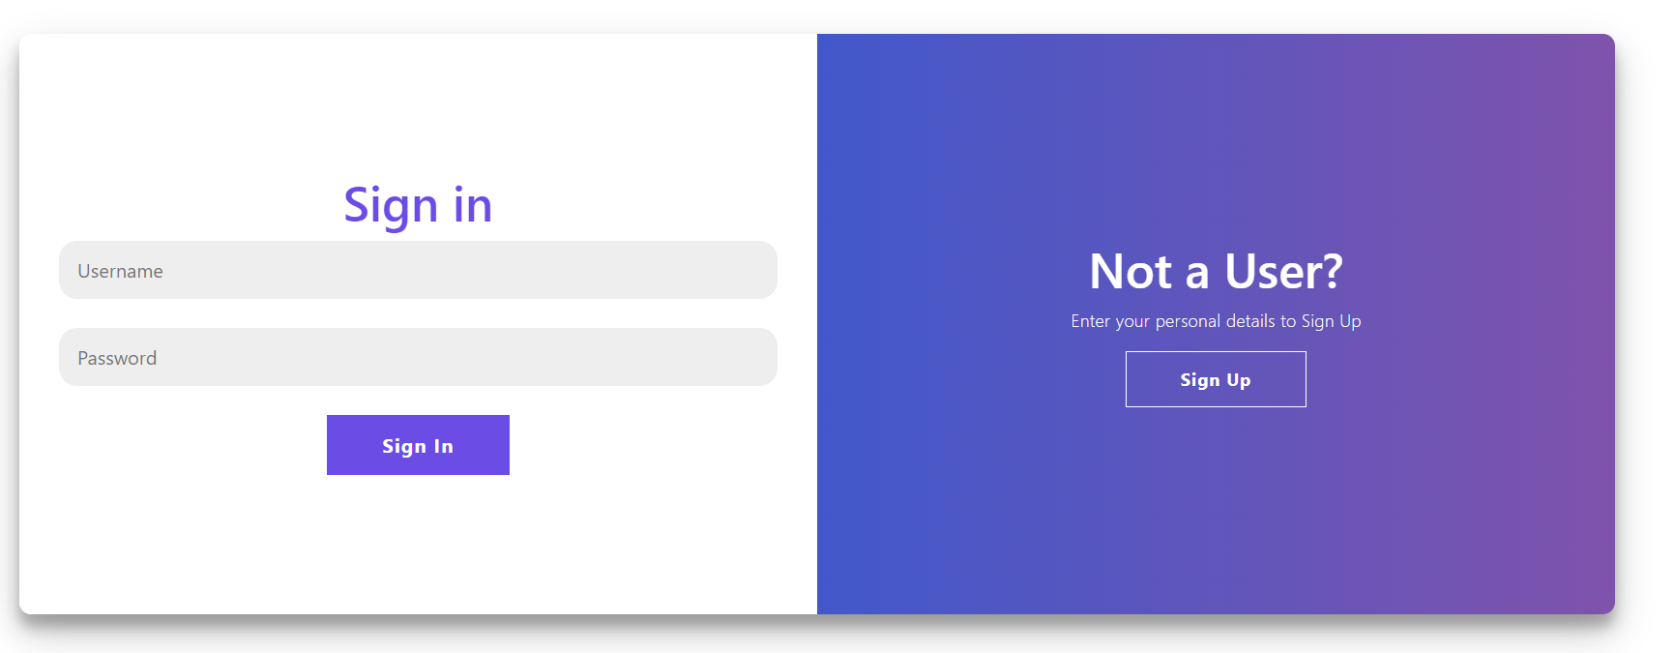
Results and Discussion

Slide 10
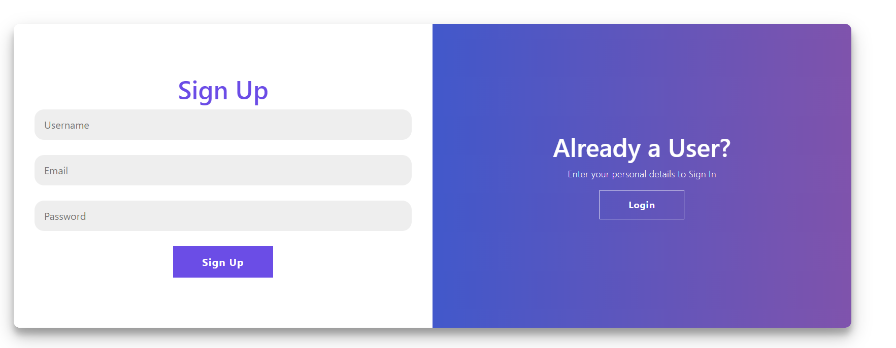
Results and Discussion

Slide 11
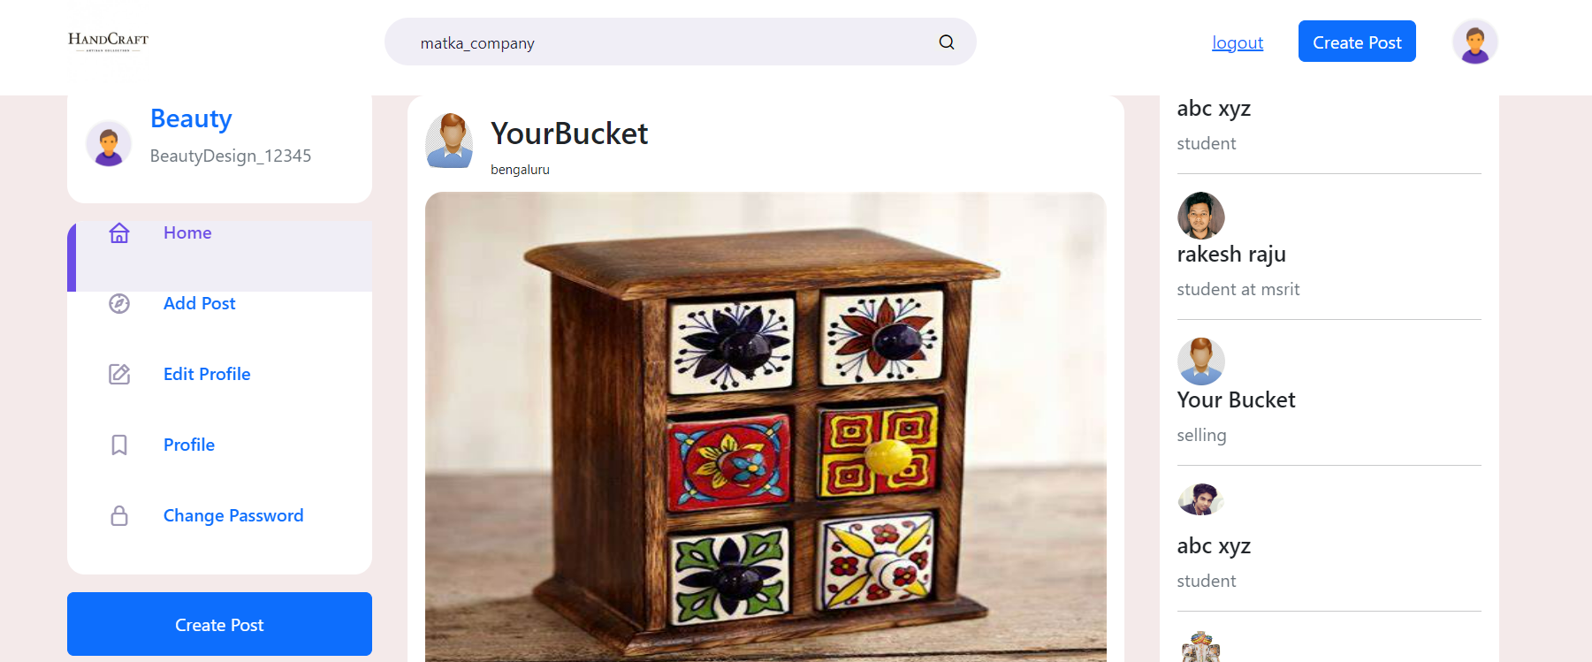
Results and Discussion

Slide 12
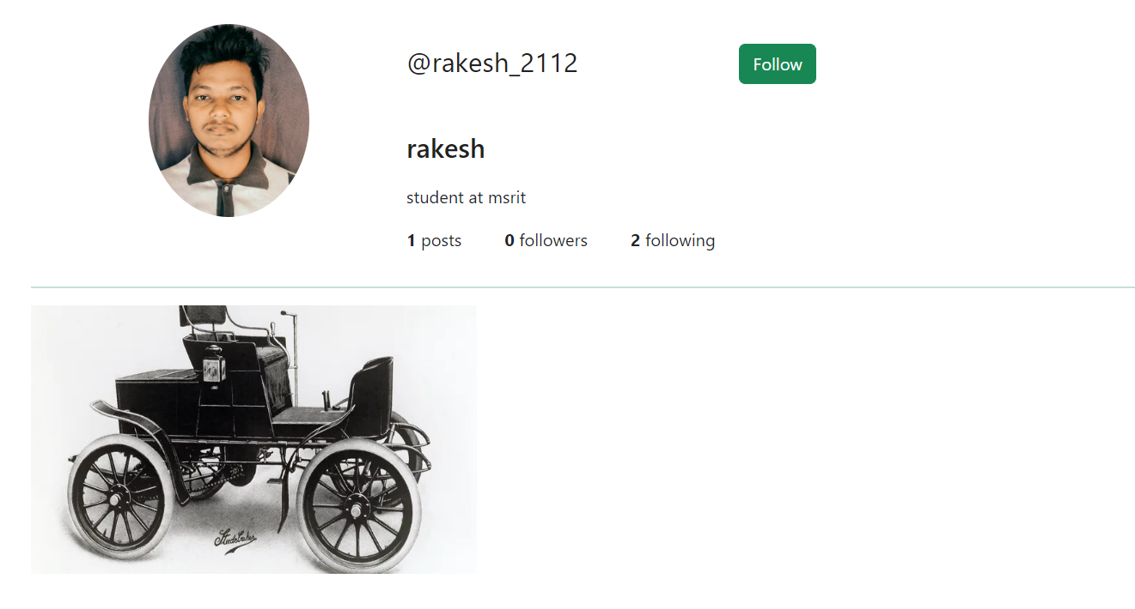
Results and Discussion

Slide 13
7. Conclusion
In conclusion, our handcraft-media combination of social media and e-commerce application project has successfully developed a comprehensive solution for artists and artisans to showcase and sell their handcrafted creations. By following a meticulous methodology, we have created a user-friendly and visually engaging platform that fosters meaningful interactions between artists and buyers.
Through extensive market research and design planning, we have ensured that the application meets the needs and preferences of our target audience. The development phase, incorporating agile methodologies and rigorous testing, has resulted in a robust and secure platform that provides a seamless browsing and purchasing experience.
Our project can not only contribute to the growth and accessibility of the handcrafted media industry but also empower artists to reach their full potential in the digital marketplace. By providing personalized recommendations, secure payment options, and social media integration, we have facilitated inclusive communication and expanded the reach of artists' creations.
In conclusion, our handcraft-media application project has achieved its objective of revolutionizing the way artists showcase and sell their handcrafted creations. Through our comprehensive methodology and meticulous execution, we have delivered a valuable platform that promotes artistic diversity, fosters community engagement, and enables artists to thrive in the digital age.

Slide 14
Thank you

